Slide 1
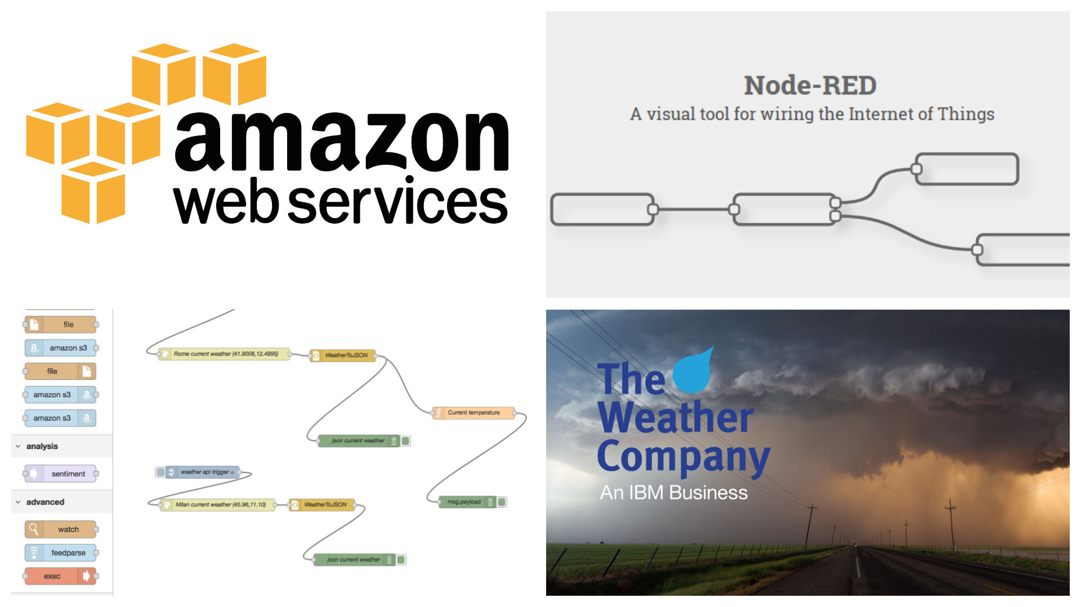
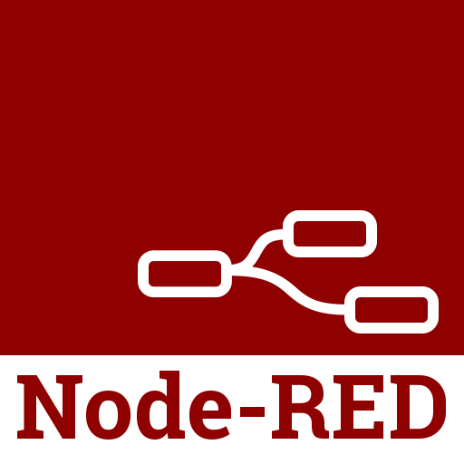



DIGITAL DEVOPS
COOL DEPLOYERS!

Slide 2



Drag Drop Deploy
MICRO SERVICES do need to talk to API’s/INTERFACES lying on some cloud. This NEEDS basic knowledge of Node-Red framework, Any developer can communicate/CONTRIbUTE to (publish/subscribe) API FLOWS using MQTT protocol and they can develop any REST APIs using http feature of Node-Red.
Node-Red is drag and drop, light weight framework built upon Nodejs. Now, developer can develop a API in lesser time that he/she takes to make a cup of coffee.

Slide 3
TRADE-OFF ON OTHER CI TOOLS
FUNCTIONALITY | EXISTING TOOLS | NODE-RED
Storage/Memory | >500 MB/ 1 GB | It can run on even RussberryPI with <500 MB ram
Reusable Flows | Needs plugins to import Jobs from other Instances | We have thousands of resusable Node Modules
User Friendly/GUI | Every tool needs some training for usage | It is as easy as Drag Drop Deploy
Platform Independent | Most of the Tools will not support all OS | As it runs on browser and all flows are inn JSON {platform independent}
Scalability | Cumbersome process | Easily adaptable to CLOUD/DOCKERS
Versioning | Manual Integration | Inbuilt feature for SourceControl

Slide 4
Node-RED is visual tool that:
1 – Provides a browser based flow editor FOR DRAG DROP and DEPLOY
3 - Wires hardware devices, Api’s and online services as part of Internet of things
3 – It is built on Node.JS
4 – His flows are stored as JSON

Slide 5
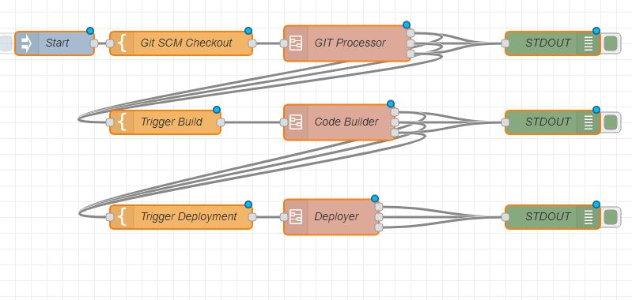
A Step Back : DataFlow Programming
Each block represent a service that we can wire simply extending the wide range nodes in the palette
- The result is a flow of data between each node

Slide 6
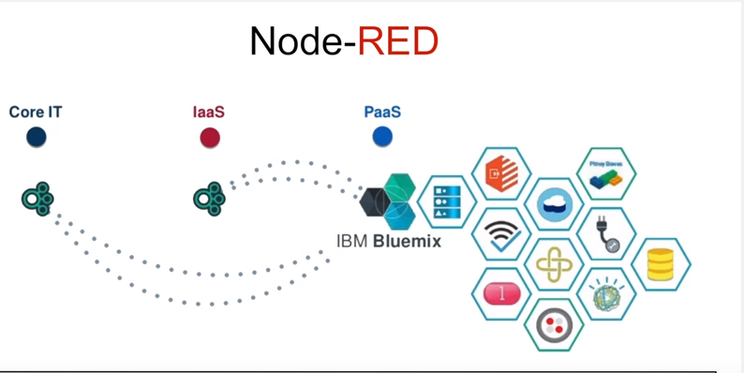
Why use Node - RED ?

Slide 7
Advantages of Node-RED
e) When Integrated with BlueMix, it provides ready made application templates for different purposes to speed up development. IOT is one of the boilerplates containing Node-red, IOT and time series database already installed
f) His flows are stored as JSON, so it is language independent
g) Its Plugin Independent unlike Jenkins
Node Red is open source, can run on low cost hardware, even on Rasberry PI as well as cloud
To run Node-Red we need only node.js and npm installed
Node-Red can easily be run on a Compatible Platform As A Service
Has yet ~2.5 Lakhs modules, and it is easy to add new capabilities

Slide 8
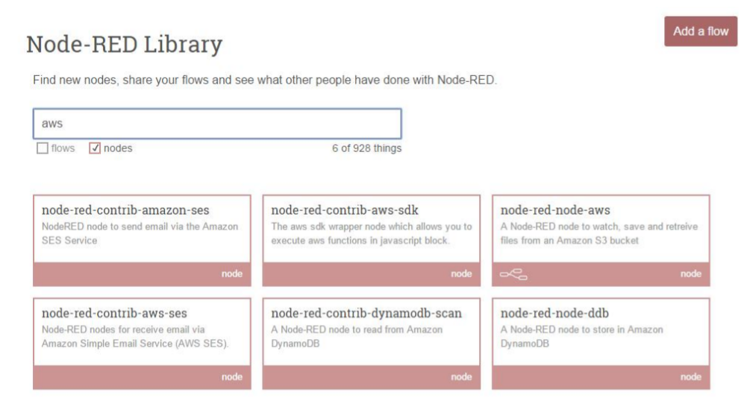
Node Red Nodes for AWS
https://flows.nodered.org/?num_pages=1

Slide 9
Coding with Node-RED
Every block represents a specific operation:
the blocks are divided by category and can be wired using the flow editor
Nodes represent reusable pieces of code and Logic. Node Red comes with core set of useful nodes .there are growing amount of additional nodes from node-red project as well as wider community and we can program our own nodes using Java Script

Slide 10
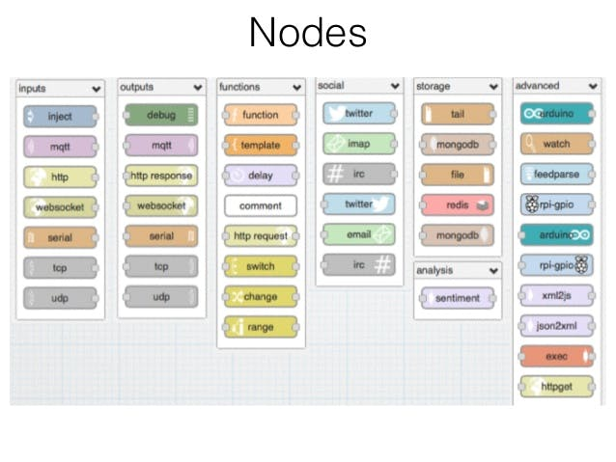

Slide 11
Security Aspects
In built LDAP node (node-red-auth-contrib-ldap)
It uses oAuthID/OpenID to login using GitHub creds
Password encryption used is BCrypt methodology which use a technique called Key Stretching.
Bcrypt is an adaptive hash function based on the Blowfish symmetric block cipher cryptographic algorithm and introduces a work factor (also known as security factor), which allows you to determine how expensive the hash function will be.
SSL based authentication

Slide 12






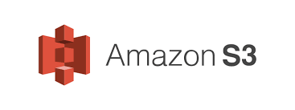



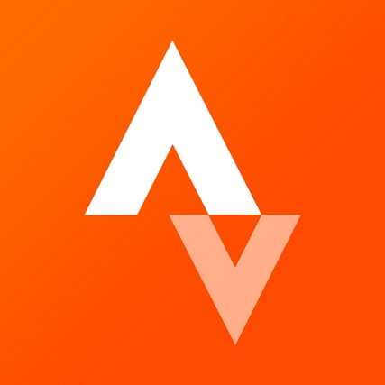


Who are using Node -RED

Slide 13
5 -Node Red Flow and Demo Time !

